Slide 1
The Traveling Sales Man (TSP)
Final Project
By: Ronney Aovida
// this is a draft submission. A submission with more images will follow

Slide 2
What is the TSP?
The Travelling Salesman Problem describes a salesman who must travel between N cities. The order in which he does so is something he does not care about, as long as he visits each one during his trip, and finishes where he was at first. Each city is connected to other close by cities, or nodes. Each of those links between the cities has one or more weights (or the cost) attached. The cost describes how "difficult" it is to traverse this edge on the graph, and may be given, for example, by the cost of an airplane ticket or train ticket, or perhaps by the length of the edge, or time required to complete the traversal. The salesman wants to keep both the travel costs, as well as the distance he travels as low as possible (to keep it optimal/efficient).
Wiki definition: The Traveling Salesman Problem is typical of a large class of "hard" optimization problems that have intrigued mathematicians and computer scientists for years. Most important, it has applications in science and engineering. For example, in the manufacture of a circuit board, it is important to determine the best order in which a laser will drill thousands of holes. An efficient solution to this problem reduces production costs for the manufacturer.

Slide 3
How this is used in the field of computational sciences
Used as a test case for almost every new (discrete) optimization algorithm:Branch-and-bound.
Integer and mixed-integer algorithms.
Local search algorithms.
Simulated annealing, Tabu, genetic algorithms.
DNA computing.

Slide 4
Some Basic approaches to solving it
The construction heuristics: Nearest-Neighbor, MST, Clarke-Wright, Christofides.
K-OPT.
Simulated annealing and Tabu search.
The Held-Karp lower bound.
Lin-Kernighan.
Lin-Kernighan-Helsgaun.
Exact methods using integer programming.

Slide 5
My Approach
To solve this problem I decided to create a minimum spanning tree.
A minimum spanning tree is a spanning tree of a connected, undirected graph. It connects all the vertices together with the minimal total weighting for its edges.
This spanning tree will provide the most optimal route of the problem in relation to the edges weights. However, it does not create a complete path to every node that routes back to the original starting point

Slide 6
How a minimum spanning tree will work in this problem
In order to solve the TSP using the spanning tree I will need to get that final edge connected in order to get the route complete.
The solution: In order to solve this dilemma we simply have to calculate the distance between the starting node and the closest node to it that is not a part of the spanning tree output already and add that edge to the solution.

Slide 7
Attaining the minimum spanning tree
To calculate the minimum spanning tree I decided to use Kruskals algorithm to attain it.
How to implement Kruskals Algorithm:At each step I will add one new edge to the tree, starting from a chosen starting point. the edges I choose are the shortest unused edge of the edge list that does not create a cycle (a cycle is a term to refer to the use of two Nodes from a given edge more than once in a spanning tree). So as long as the two Nodes from a given edge does not occur more than once in the tree then a cycle is avoided.

Slide 8
The overall solution
To solve the TSP, the user will need to first insert the coordinates that pertain to the vectors of the edge list they want to create, such as the coordinates of a cities map (but in a x,y format of course).
These coordinates and vectors are then computed into a edge list that is sent into Kruskals algorithm, as previously stated it will turn run through every possible edge and return a minimum spanning tree, making sure not a single edge is repeated.
In order to complete the route however another edge will be have to added to the spanning tree.
By calculating the distance from the starting node to the nearest node that has not been given an edge from the spanning tree, the route is then near optimally calculated.

Slide 9
Comparing approaches
Many approaches are used to calculate this TSP, however many have their ups and their downs.some are quick, but yet not accurate. Where as some are more accurate but extremely slow to run.
An example of a extremely fast approach is the nearest-neighbor heuristic (a greedy algorithm). Where it simply goes to the nearest edge with the lowest weights from the starting point and from the node connected to the edge it does the same thing until it reaches the end node. The problem with this approach is how inaccurate its results are.
An example of a extremely accurate or say optimal approach is currently known as the branch and bound algorithm. This algorithm is very complicated in comparison to the nearest neighbor alg. The problem with this approach however is the slow speed of this approach.
Using the minimal tree approach is in the goldilocks zone, where it is not neccesarily the most accurate, but also not the slowest either.

Slide 10
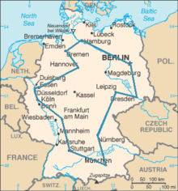
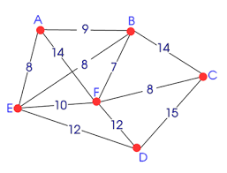
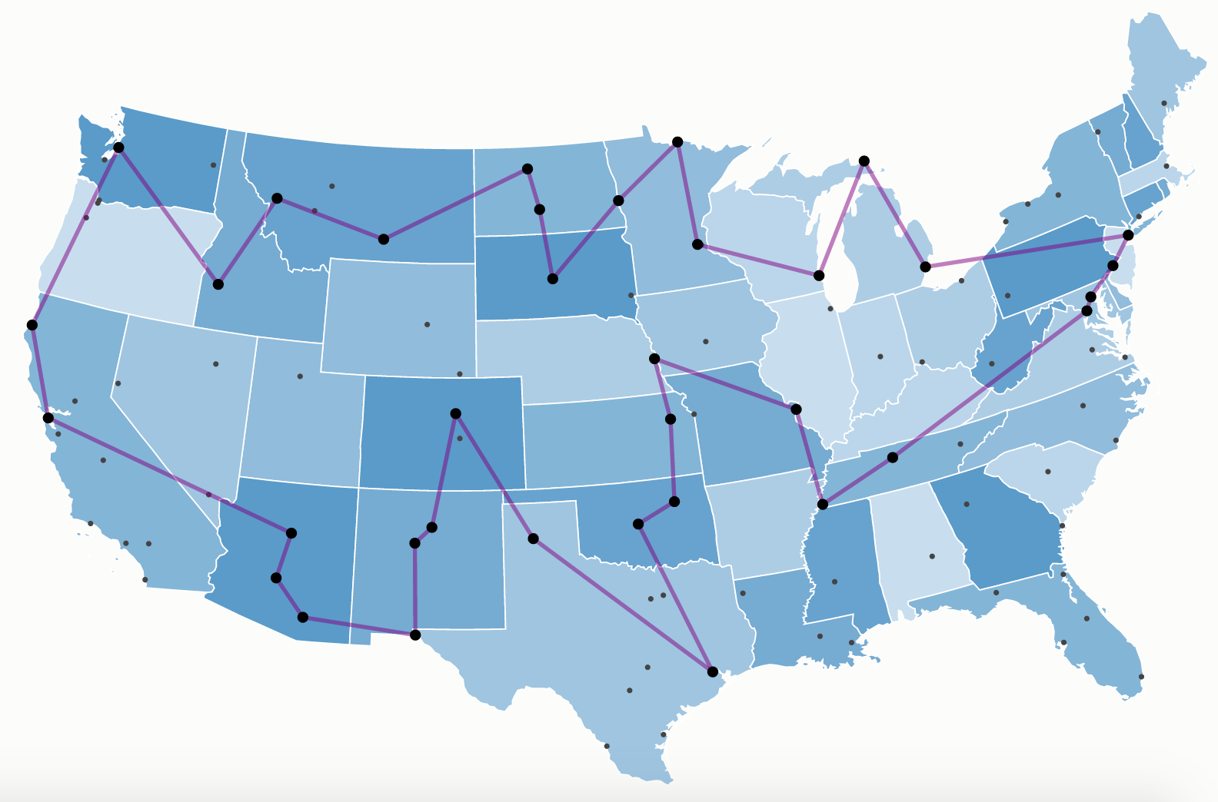
Visuals of TSP

Slide 11
Conclusion
The TSP to this day remains to be one of the few problems that have yet to be fully solved since any algorithm today has yet to reach a 100% accuracy in efficiency compared to solving it by hand.
Perhaps one day in the future a algorithm will reach the optimal accuracy our human brains are capable of, but until then using any of the previously stated algorithms should suffice for saving a lot of time since our human brains are much slower than any algorithm at the expense of being more accurate that any algorithm as well.

Slide 12
References/sources
https://www.seas.gwu.edu/~simhaweb/champalg/tsp/tsp.html
https://simple.wikipedia.org/wiki/Travelling_salesman_problem

